Slide 1
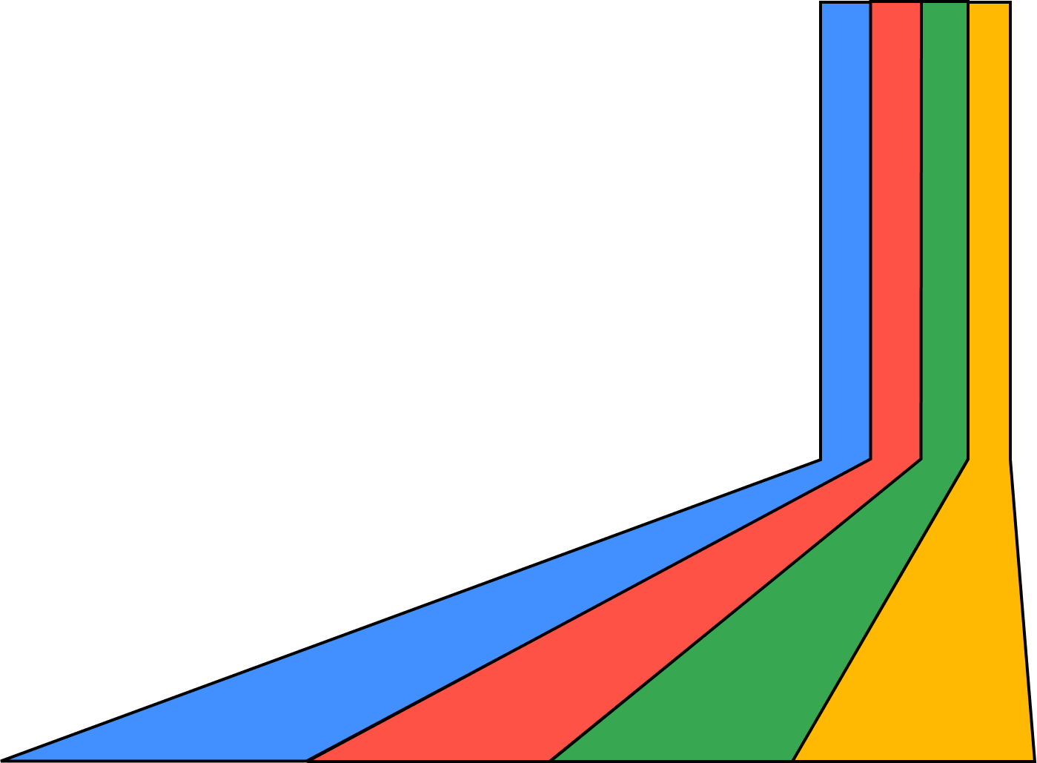



Top Web things at Google I/O 2k23

Slide 2
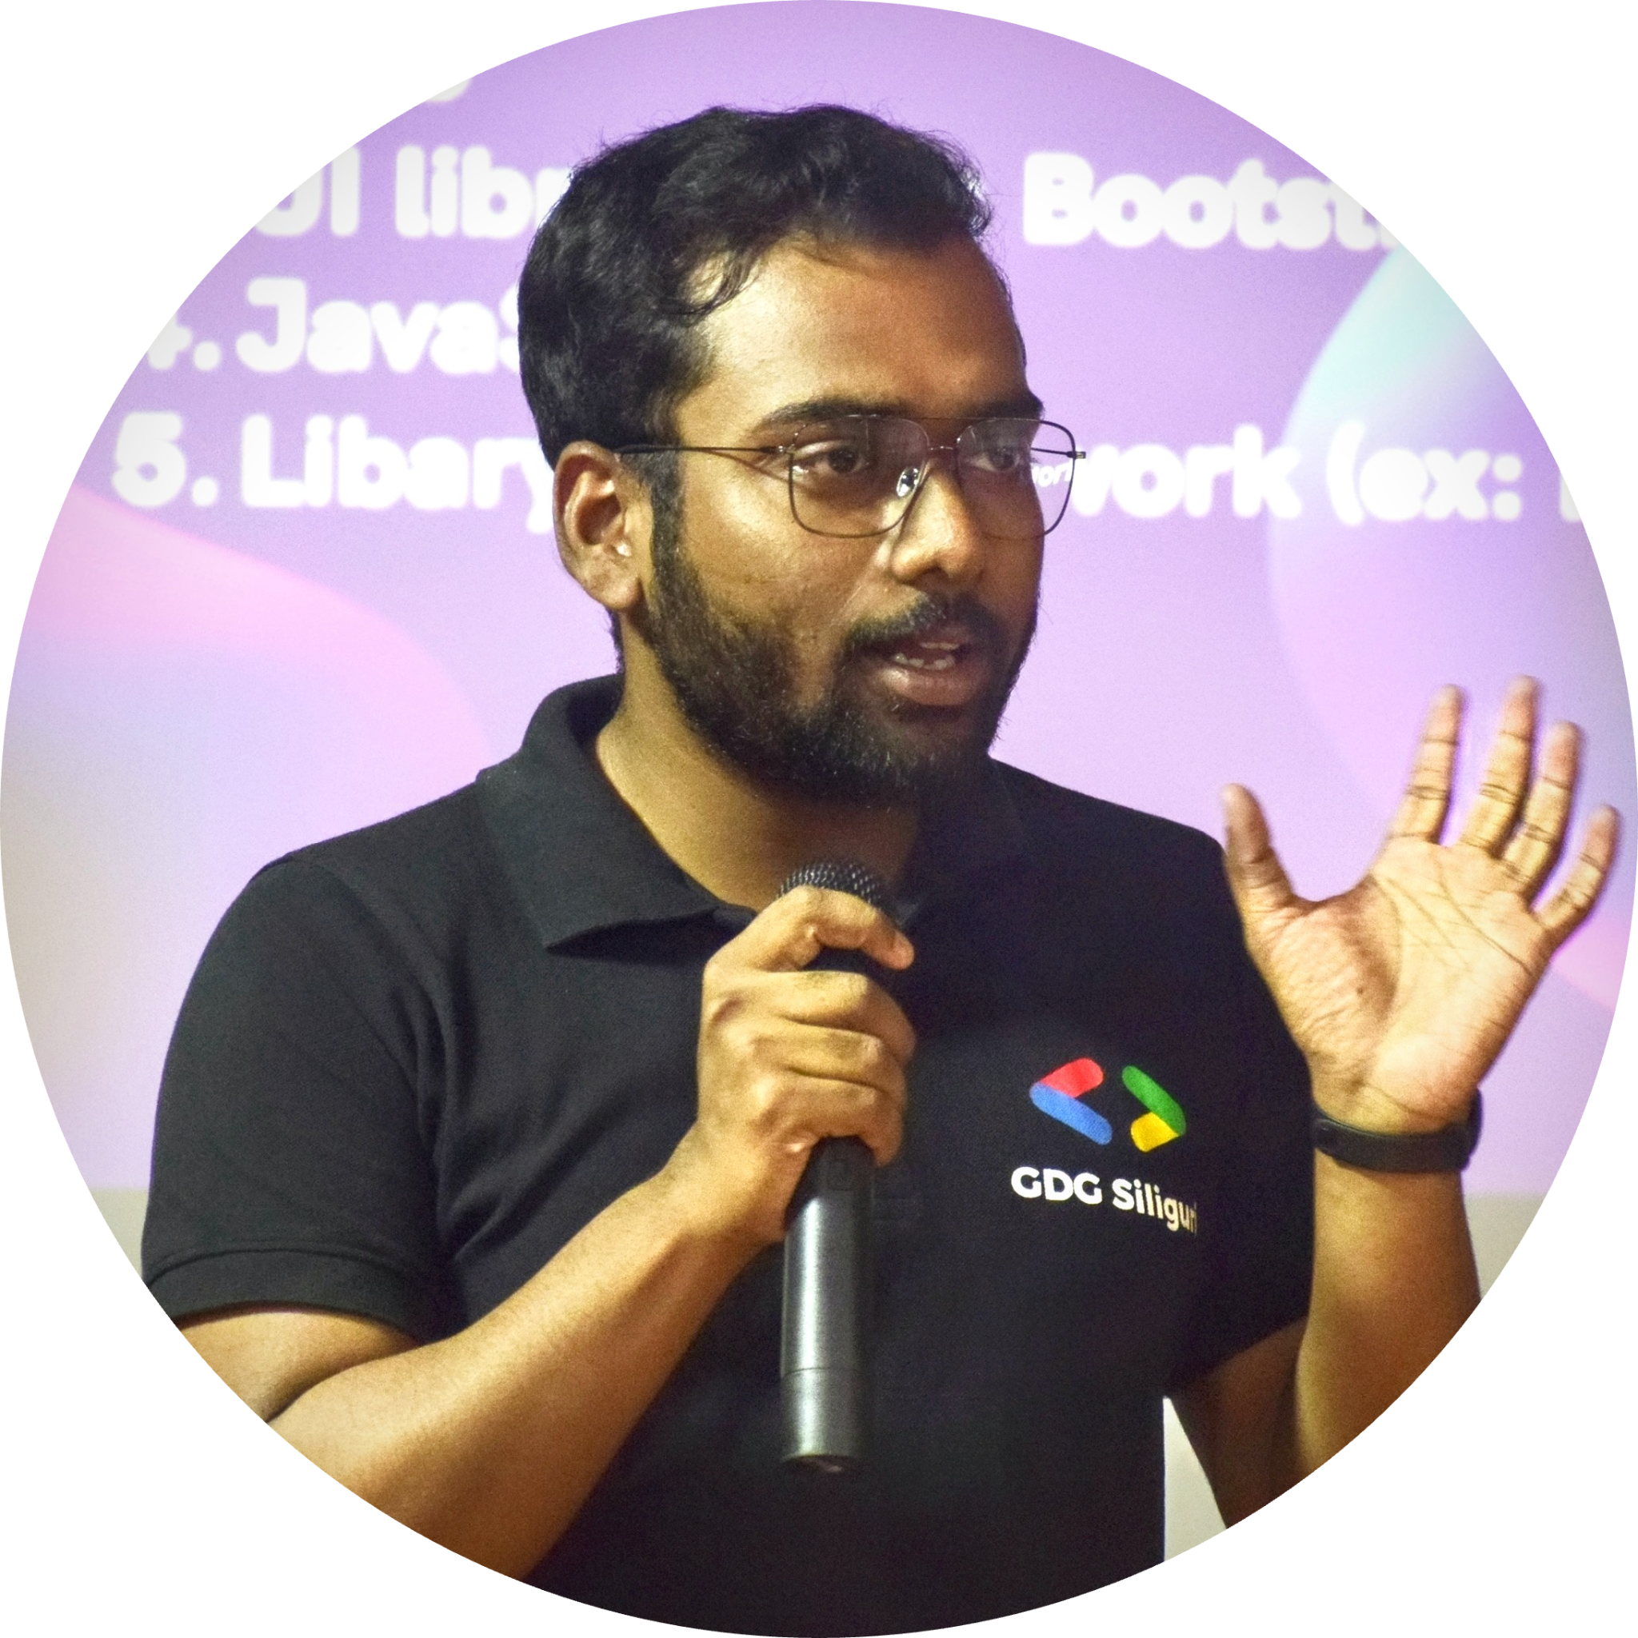


About Me
Debajit Mallick
Software Engineer @P360,
Organizer @Google Developers Group Siliguri

Slide 3


Baseline
Web Platform Baseline gives you clear Web Platform Baseline gives you clear information about which web platform features are safe to use in your projects today. Information about which web platform features are safe to use in your projects today.
The Chrome team is collaborating with other browser engines and the web community to bring more clarity. This includes our work on projects like Interop 2023 which helps to improve interoperability of a set of key features.
in/debajit-mallick/
@MallickDebajit

Slide 4
Baseline features you can use today
The dialog element.
Individual CSS transform properties.
New Viewport units.
Deep copy in JavaScript.
The :focus-visible pseudo-class.
in/debajit-mallick/
@MallickDebajit

Slide 5
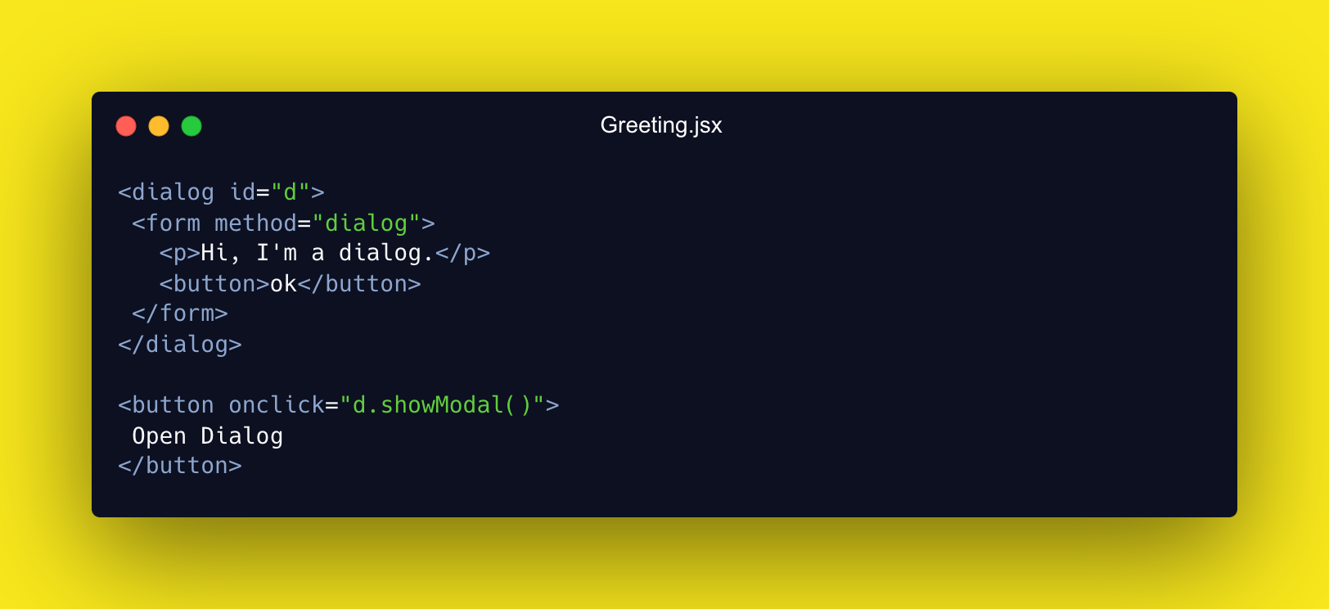
The dialog element
in/debajit-mallick/
@MallickDebajit

Slide 6
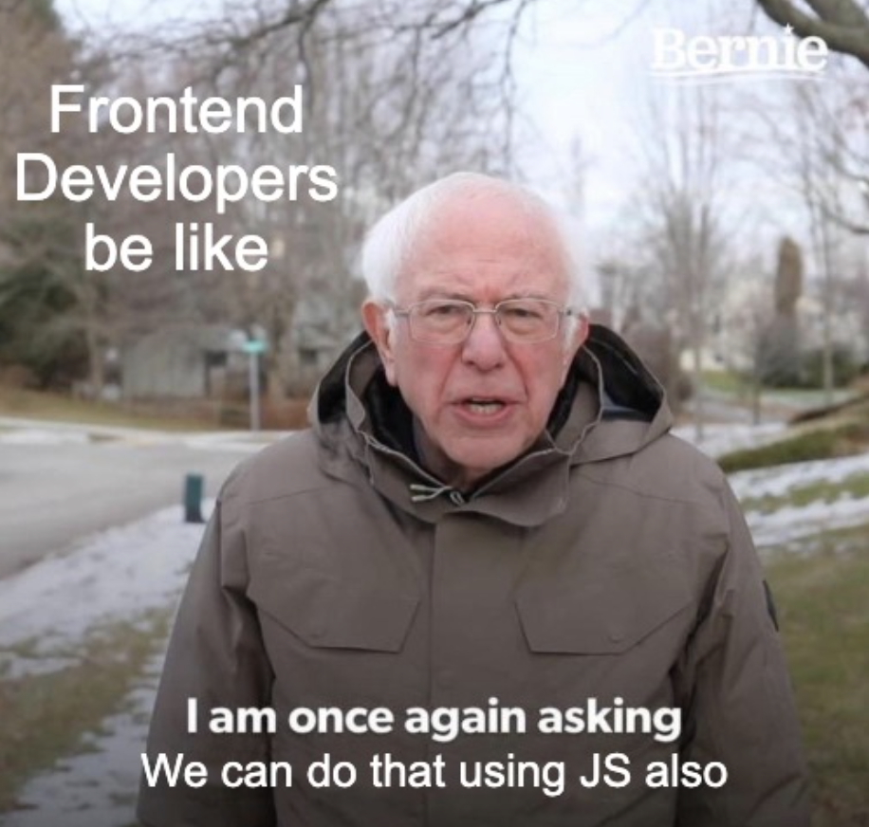
Frontend Devs be like
in/debajit-mallick/
@MallickDebajit

Slide 7
Why we use dialog then?
As a native HTML element, features like
focus management,
tab tracking, and
keeping the stacking context
are built in.
in/debajit-mallick/
@MallickDebajit

Slide 8

What you can build using dialog?
in/debajit-mallick/
@MallickDebajit

Slide 9
Individual CSS transform properties
> This comes in handy when you are writing complex keyframe animations
@keyframes anim {
0% { transform: translateX (0%) ; }
10% { transform: translate(10%) rotate (72deg) scale (1.2); }
25% { transform: translate(25%) rotate (180deg) scale (1.2); }
85% { transform: translate(85%) rotate (180deg) scale (1.2); }
90% { transform: translate(90%) rotate (240deg) scale (1.2); }
100% { transform: translate(100%) rotate (360deg) ; scale(1.5);}
}
@keyframes anim {
0% { translate: 0% 0; }
100% { translate: 100% 0; }
0% { scale: 1; }
10%, 90% { scale: 1.2; }
100% { scale: 1.5; }
0% { rotate: Odeg; }
25%, 85% { rotate: 180deg; }
100% { rotate: 360deg;}
}
in/debajit-mallick/
@MallickDebajit

Slide 10
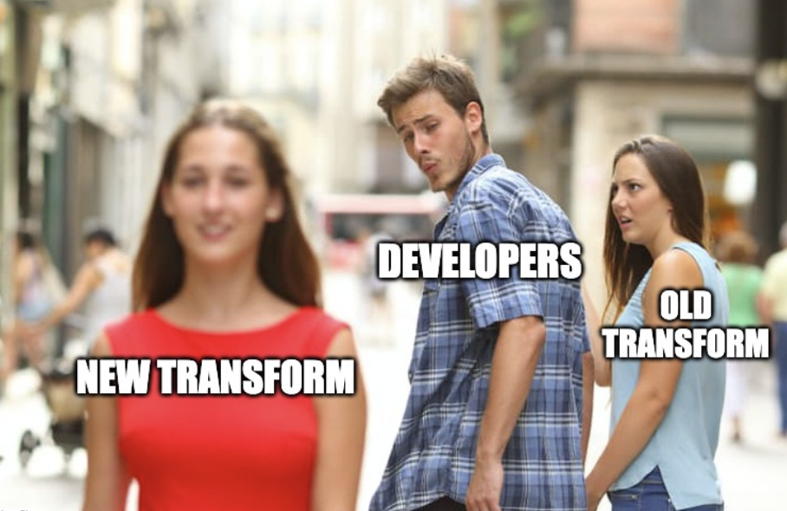
in/debajit-mallick/
@MallickDebajit

Slide 11
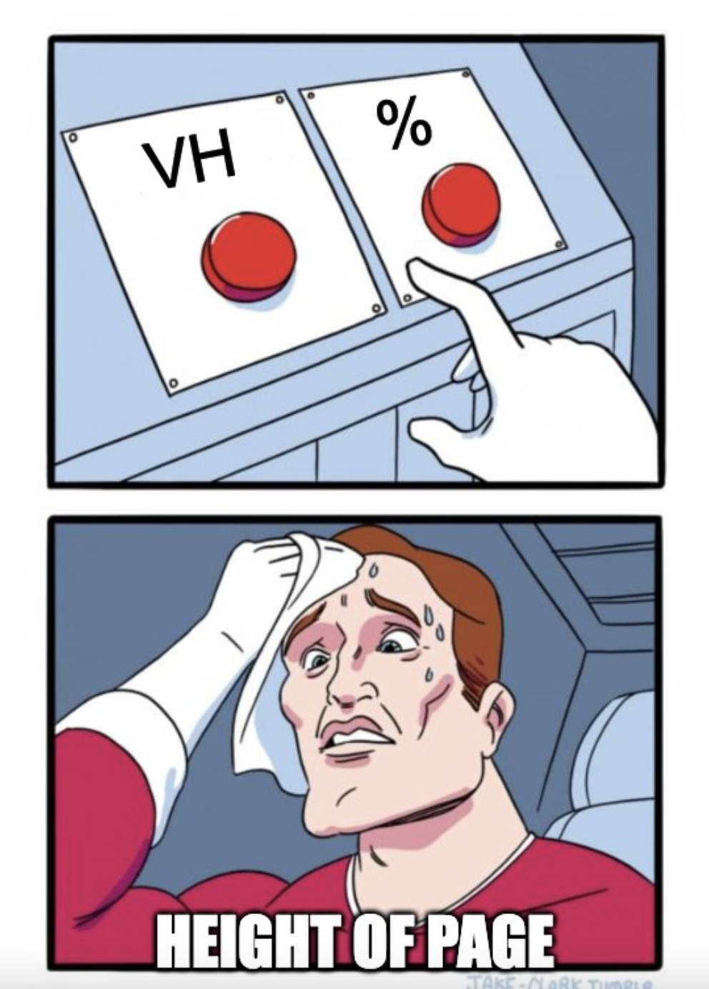
Setting height of the page
in/debajit-mallick/
@MallickDebajit

Slide 12
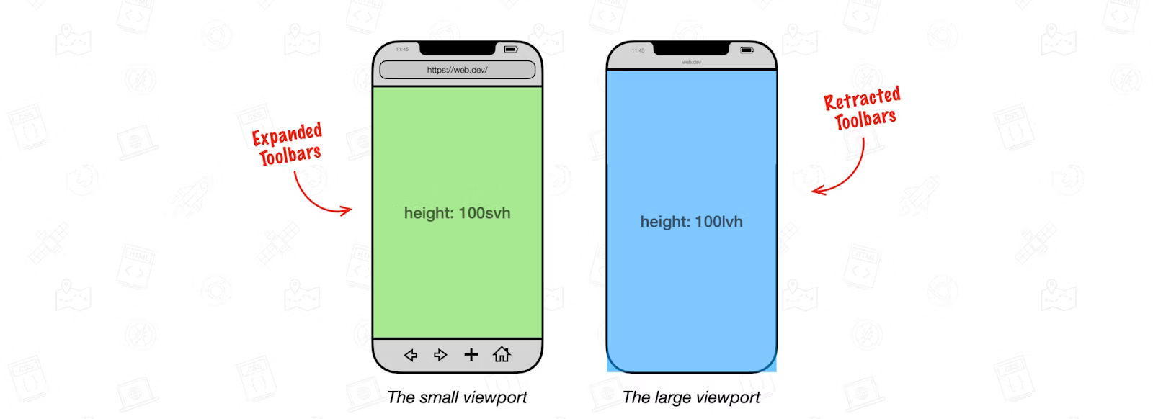
New Viewport Units
svh
lvh
in/debajit-mallick/
@MallickDebajit

Slide 13
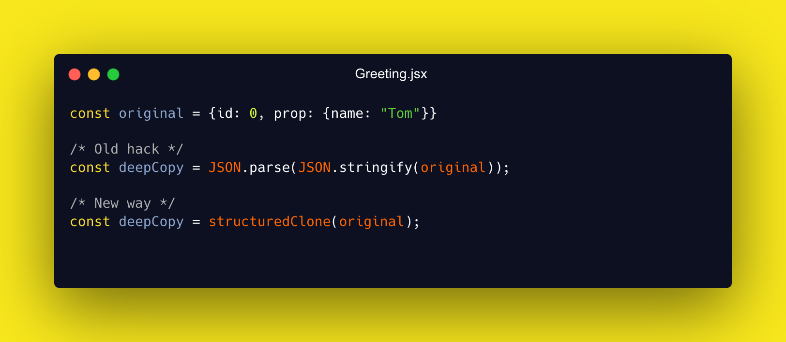
Deep Copy in JavaScript
in/debajit-mallick/
@MallickDebajit

Slide 14
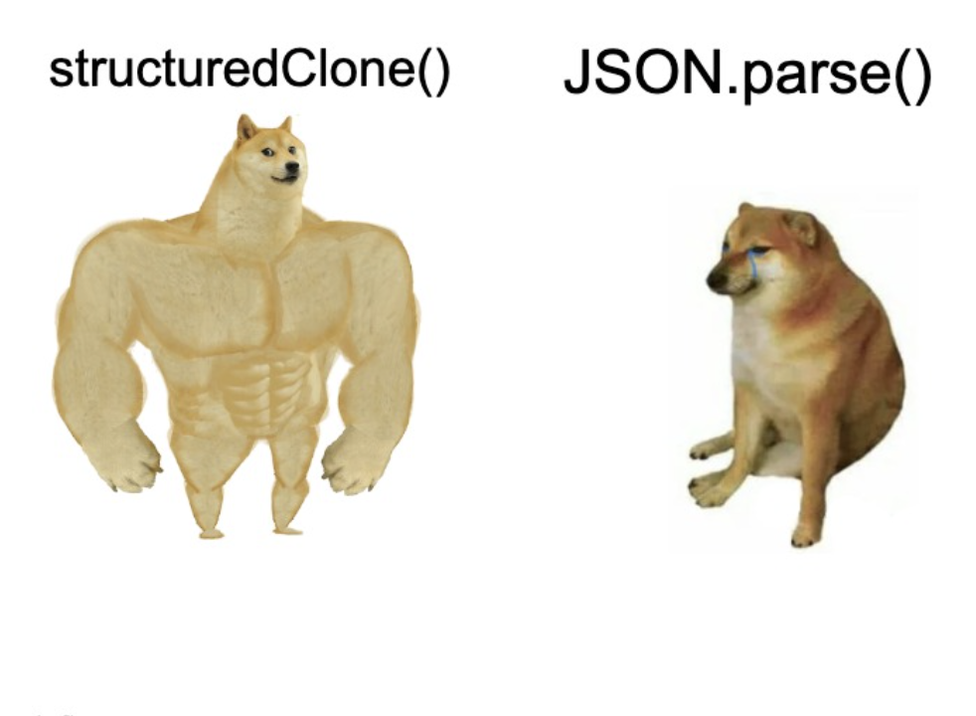
Deep Copy be like
in/debajit-mallick/
@MallickDebajit

Slide 15
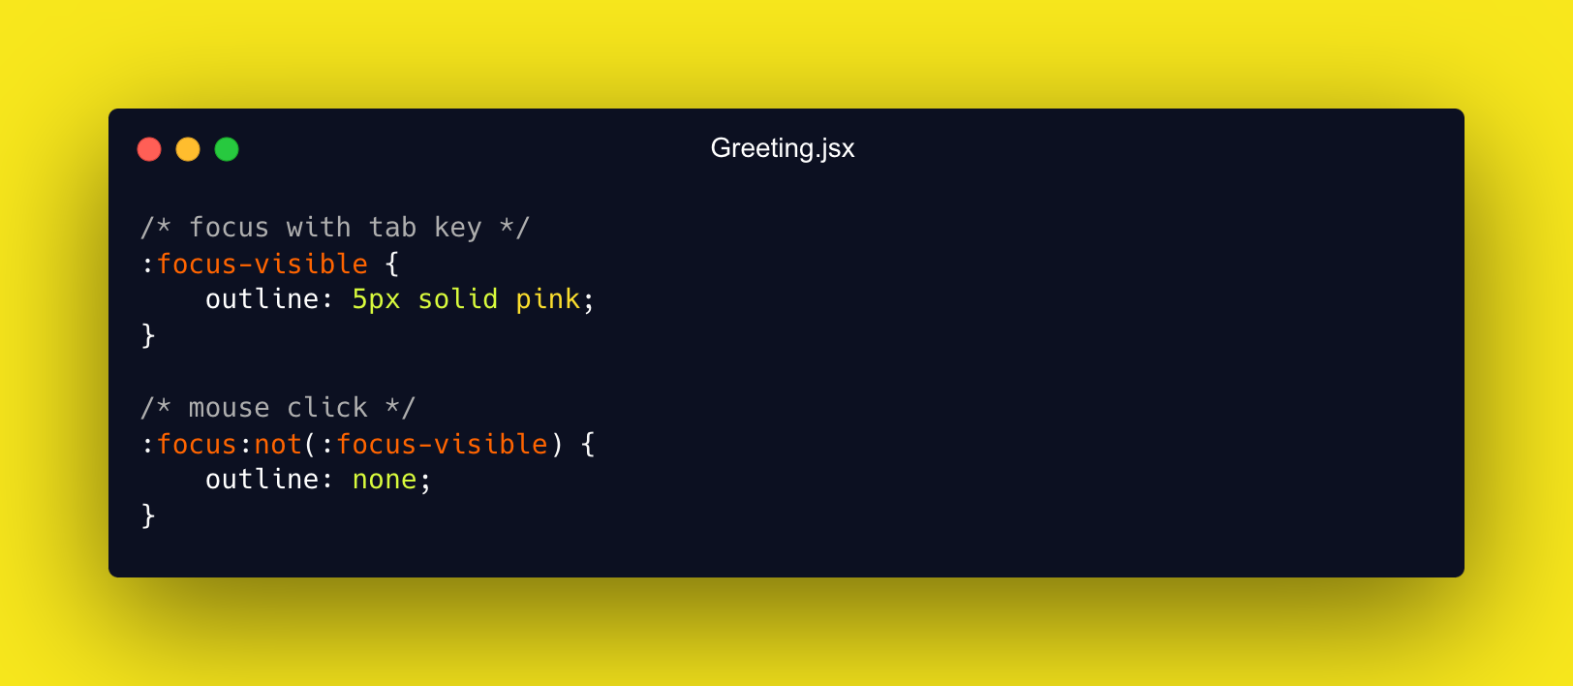
The :focus-visible pseudo-class
We all are familiar with that "focus ring" that shows up when you are navigating a page with a keyboard or clicking on input elements.
in/debajit-mallick/
@MallickDebajit

Slide 16
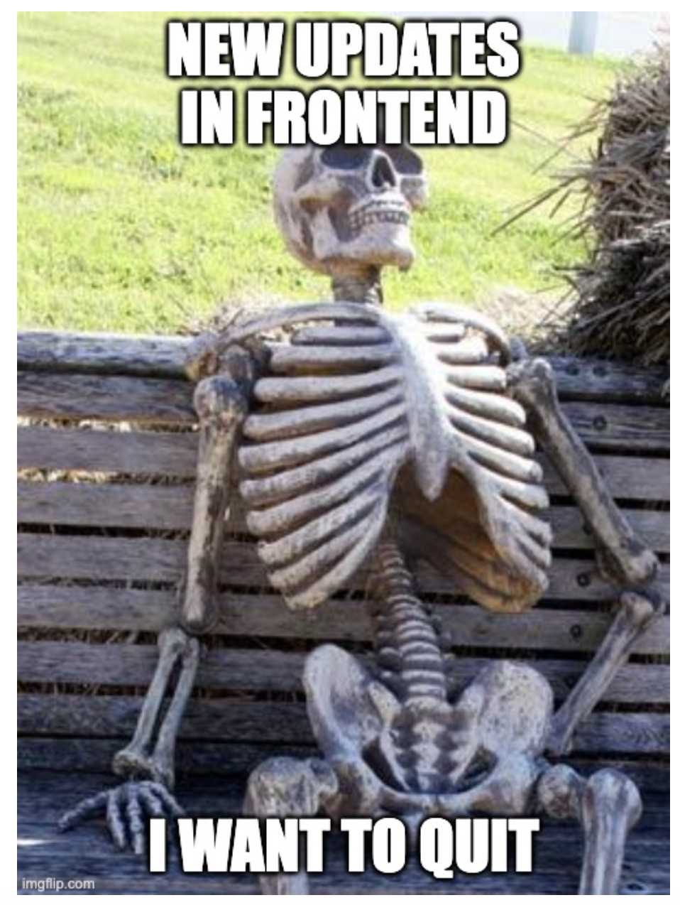
Frontend tech changes a lot
in/debajit-mallick/
@MallickDebajit

Slide 17

Thank You
For being such an amazing audience
Scan the QR & lets connect!
https://gdg.community.dev/gdg-siliguri/

Slide 18

Join the Fam!
We welcome you to our GDG Siliguri Community!
Scan the QR & Join our family!
https://gdg.community.dev/gdg-siliguri/

